Slide 1
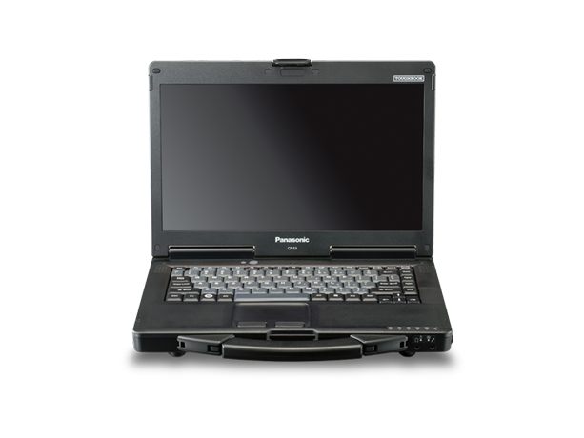
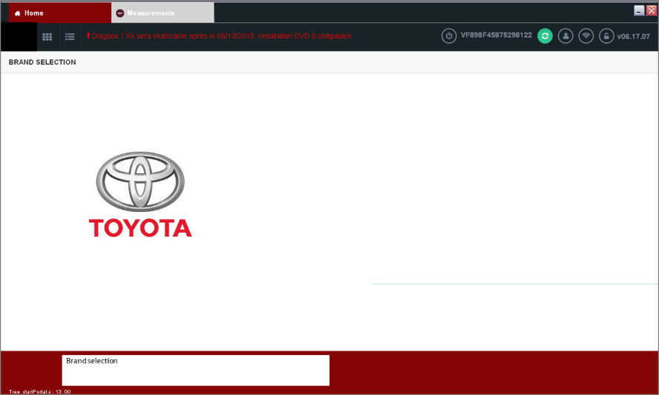
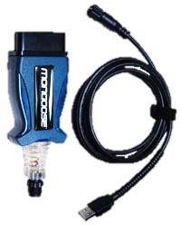
DiagBox for Toyota-Installation guide
Notes:
DiagBox on GTS

Slide 2
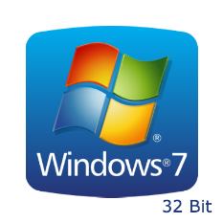
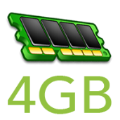
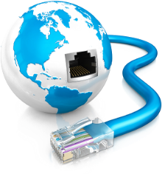
Diagbox implementation-> PC and OS specifications
This presentation will guide trough the necessary steps to be followed
in order to install the Diagbox software.
Before starting the download proccess, please make sure that your PC
fulfils the requirments needed for the installation of Diagbox:
OS: Windows 7 on 32bit ( PSA official OS)
Windows 7 on 64bits is not officially supported by PSA but TME has requested PSA to insure compatibility.
Current status:
OK for K0
OK for G9 but sometimes VIN is not automatically read. Input manually the VIN and diagnostic is possible.
Windows 10: Not supported within 2016. Later support TBC.
PC specifications
Proccessor: min frequency of 1.9 GHz, recommended I5
RAM: minimum 4Gb
HDD: minimum 11 Gb free for Diagbox suite
Screen resolution: minimum 1024x768 (VGA), screen rotation disabled
Internet Explorer: 8, 9, 10 or 11
Mandatory:
Internet connection ( without Proxy)
Run under PC admin account

Slide 3
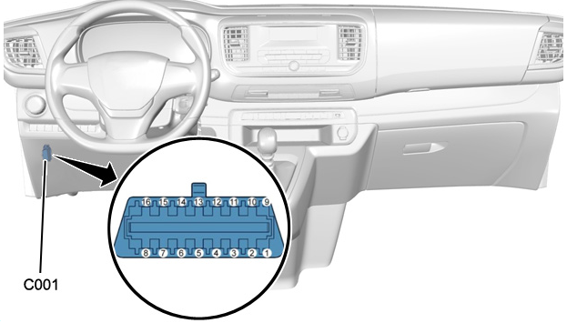
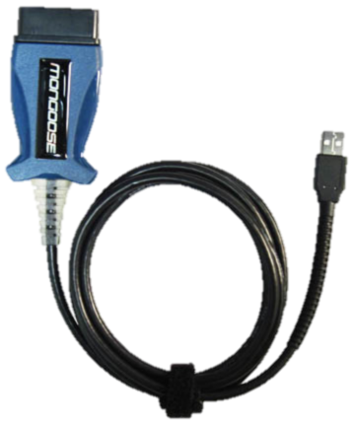
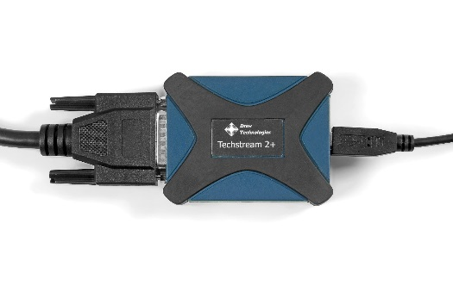
Must have equipment
Vehicle Interface Module with 2 CAN channels:
MongoosePro Toyota 2 Bluetooth ( Pro MFC2 BT RC2)
Or
Mongoose TS2+
Dual
CAN
Pin 6: IS CAN High
Pin 14: IS CAN Low
Pin 7: K line
Pin 3: PSA CAN Diag High (BSI1)
Pin 8: PSA CAN Diag Low(BSI1)
ECU
Reflash
As PSA uses different DLC3 pins, the usage of a dual CAN vehicule interface is mandatory
Diag+
ECU Reflash via BSI
Please make sure that you have installed the correct drivers for your Mongoose device!
Notes:
DiagBox on GTS
MongoosePro® Toyota 2
Product Capabilities:
Support for DLC3 (OBD II) from 1996-present
Diagnostic Trouble Codes
Data List
Active Test
Monitor
Utility
Reprogramming
Health Check
Customize (C-Best)
Optional Bluetooth version - for wireless PC connectivity
Bluetooth Version:
The MongoosePro Toyota 2 Bluetooth is a wireless version of the MongoosePro Toyota 2. This Mongoose can be used while connected with USB or wirelessly connected to the PC via Bluetooth.
The Bluetooth version is great for diagnostics as it allows more freedom for PC placement with an approximate 30 foot range. It is highly recommended, however, not to use the Bluetooth version while reprogramming vehicle modules. If you would like to purchase a Bluetooth MongoosePro Toyota 2, make sure to check the "Bluetooth Version" checkbox.
The link between the VIM and the diagnostic tool may be hardwired or by Bluetooth.

Slide 4
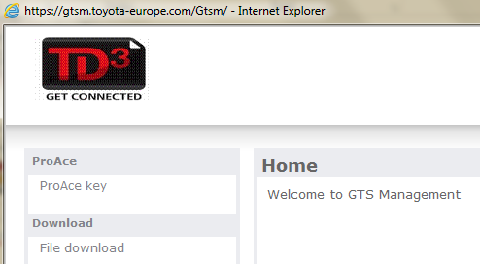
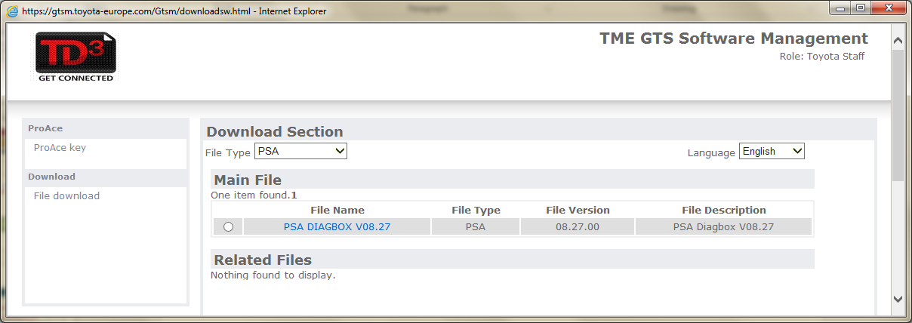
Step 0: Where can you obtain software?
Go to -> mytechdoc.toyota-europe.com-> GTS Software
ProAce key (or AP code) will provide you your personal access code.
File download will provide you the normal software distribution page. Select the file type to PSA and you will retrieve the Diagbox installer.

Slide 5
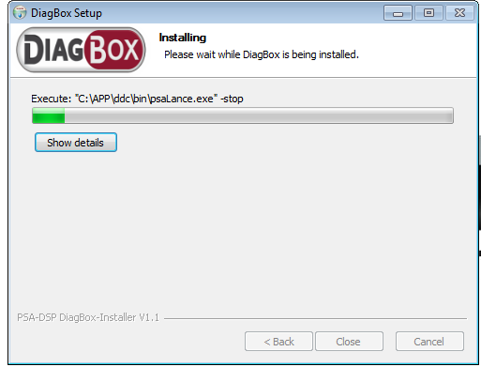
Step 1: Open the downloaded file
Step 2: Select your preferred language
After selecting your preferred language, click OK and installation will start

Slide 6
Step 3: Accept the firewall requests
Durring the installation and at the first start of Diagbox software, you will receive Firewall permition requests.
Important:Please make sure that both “ Private networks” and “ Public networks” cases are selected.
For all Firewall requests, with the 2 cases selected, always click Allow access

Slide 7
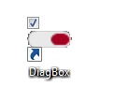
Step 4: First start of Diagbox
At the end of the installation proccess on your desktop you will now find a Diagbox icon
When opening, you will receive a request for creating a firewall exception for each component of Diagbox that needs to communicate via the Internet. Please accept all requests for both public and private networks!

Slide 8
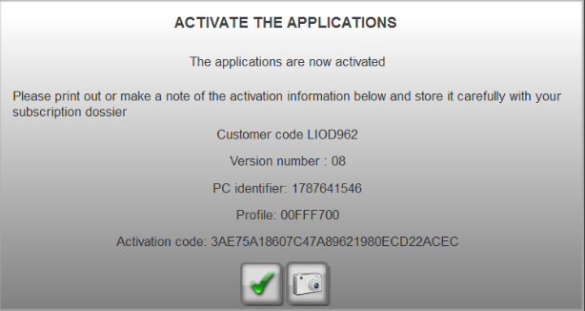
Step 5: Mandatory activation
Div:TME-A/S Until: Indefinite
Diagbox can not be used without being activated.
The activation code will be given to technicians only on request and not displayed openly on communication documents.
TME_test
1127F080

Slide 9
Important: save and store safelly your activation details

Slide 10
Step 6: Input your credentials

Slide 11
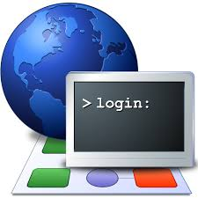
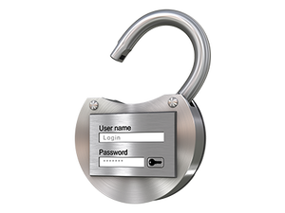
Activation and de-activation: mandatory steps
For using Diagbox users must activate it. But if total number of active user (300) is reached, additional requests are not accepte ( code29).
Important: After first installation and later on, If you do not want to use the Diagbox software within the hour, please de-activate your session!
X (# active users)< 300
X+1
X = 300 users
Code 29

Slide 12
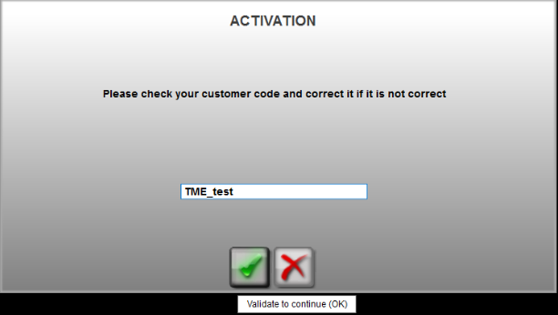
DiagBox activation step by step
Startup screen with disabled DiagBox
Fulfill your client code
Time to complete :
About 10s
Internet access mandatory
TME_test
1127F080

Slide 13
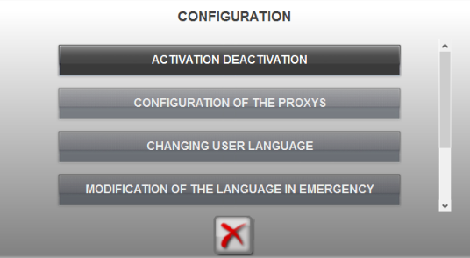
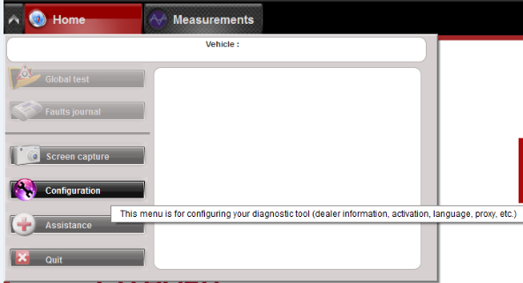
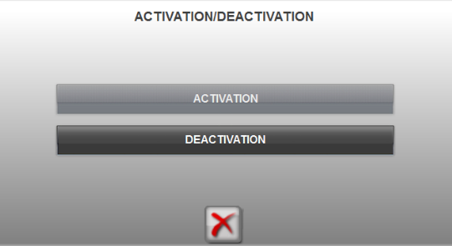
DiagBox activation step by step
Reminder : If you do not want to use the Diagbox software within the hour, please de-activate your session!!!
Configuration menu only available when there is no vehicle selected
Time to complete :
About 15s
Internet access mandatory
➔ License is released on server side and can be used by another user for diagnostic
X-1

Slide 14
Step 7: check for updates ( Internet required)

Slide 15
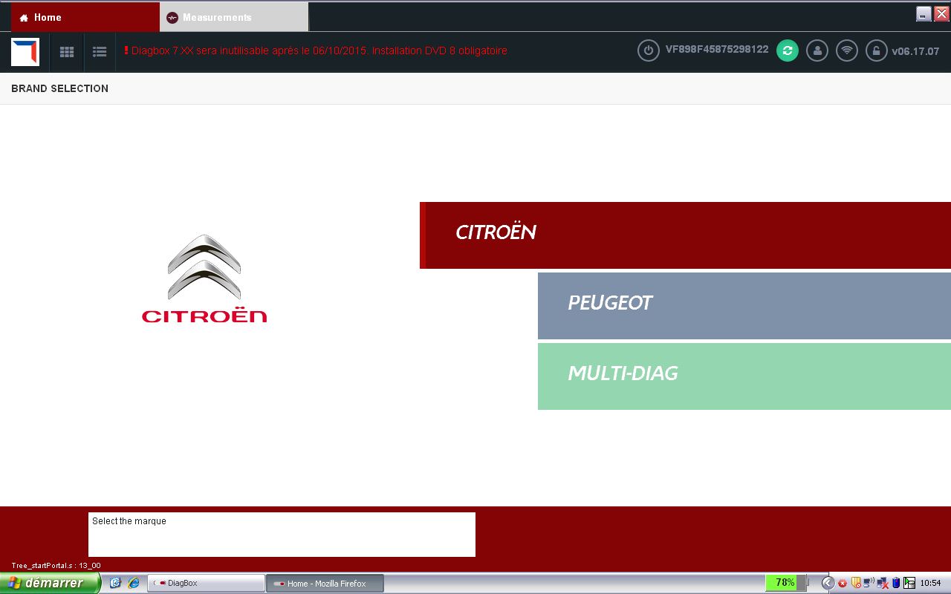
Step 8 : Confirmation of Internet connection and user registration
Authentication
Connected to Internet
Important: Making sure that you are authentificated ( and connected to internet) should be the first action that you perform after opening Diagbox software.
This will insure direct communication with the PSA server that will later need for diagnostic, configuration and ECU refiash.
For doing this, please click on the User pictograme.
Procedure on how to obtain your access code in the next slide-->
Brand selection

Slide 16
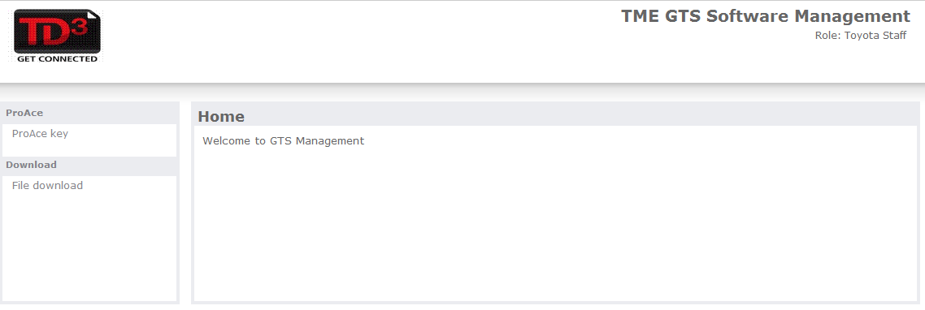
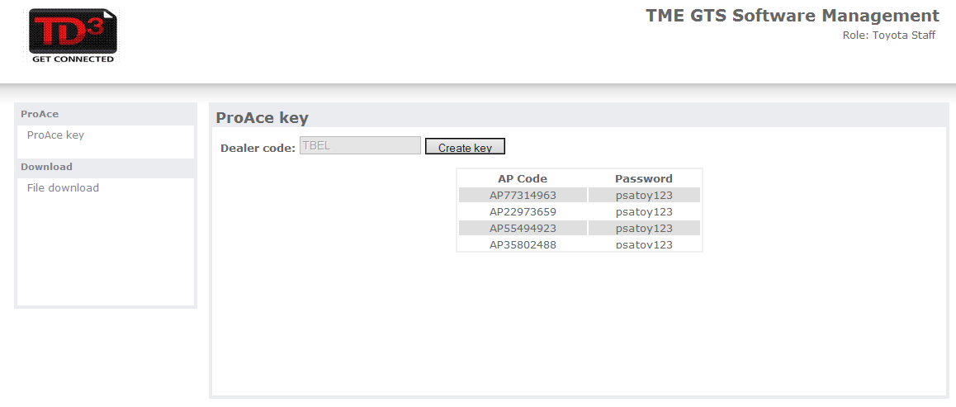
How to obtain you personal access code:
For obtaining you AP code you go on:
TD3-> GTS Software-> ProAce Key
Dealer must fill in his Dealer Code ( last digits of his TD3 account) and click Create Key
The AP code and PW generated will be used for registering in the Diagbox menu

Slide 17
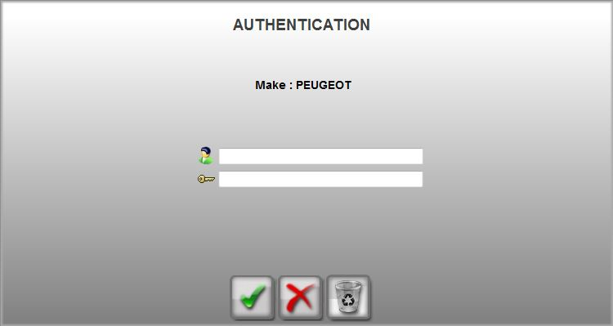
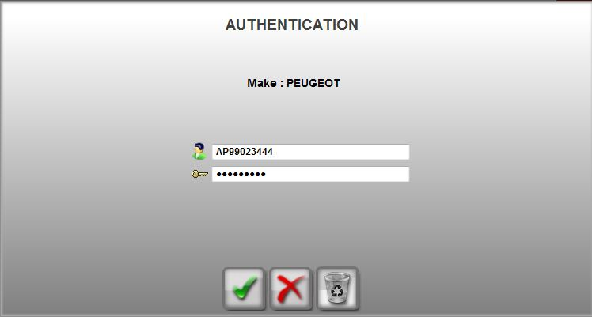
Confirmation of Internet connection and user registration
Important: Click on the user pictograme and fill in the AP code received from TD3 starting with Apxxxxxxxx
For password, fill in the received one.
If credentials are accepted both leds are now greeen.

Slide 18
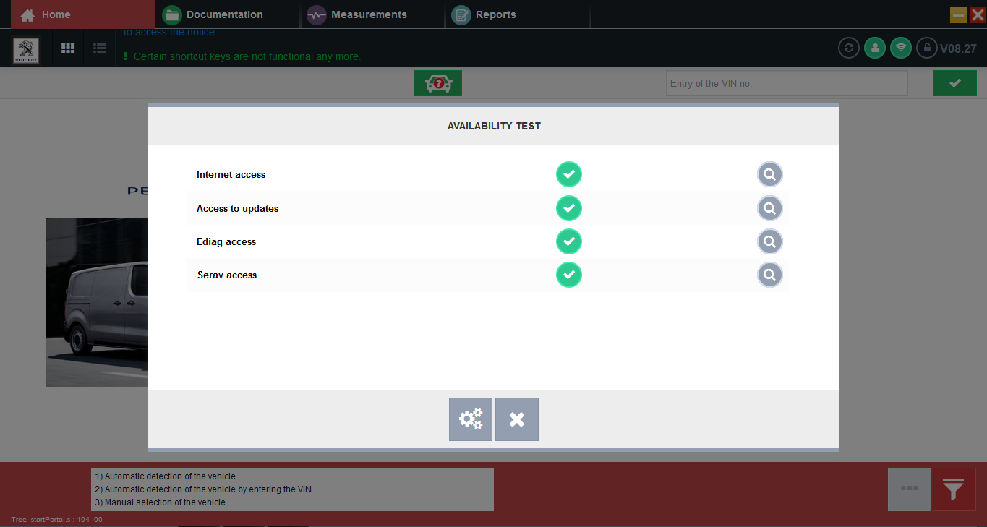
Confirmation of connection to server
Important: If even in doubts about the connection to the PSA server ( failed automatic config, impossible to retrieve ECU software), you can test the connection by pressing on the Internet pictograme or press F12

Slide 19
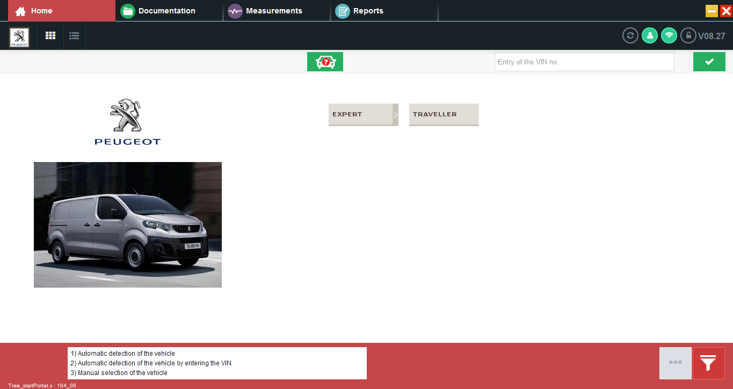
Ready!
Worning: the current software doesn’t use the Toyota logos or naming.
For connecting to vehicles using V 8.27:
-For the new Proace you select either Expert K0 or Traveller for ProAce Verso
For connecting to previous generation ProAce, select Expert 3

